Slide 1

AWK COMMAND

Slide 2
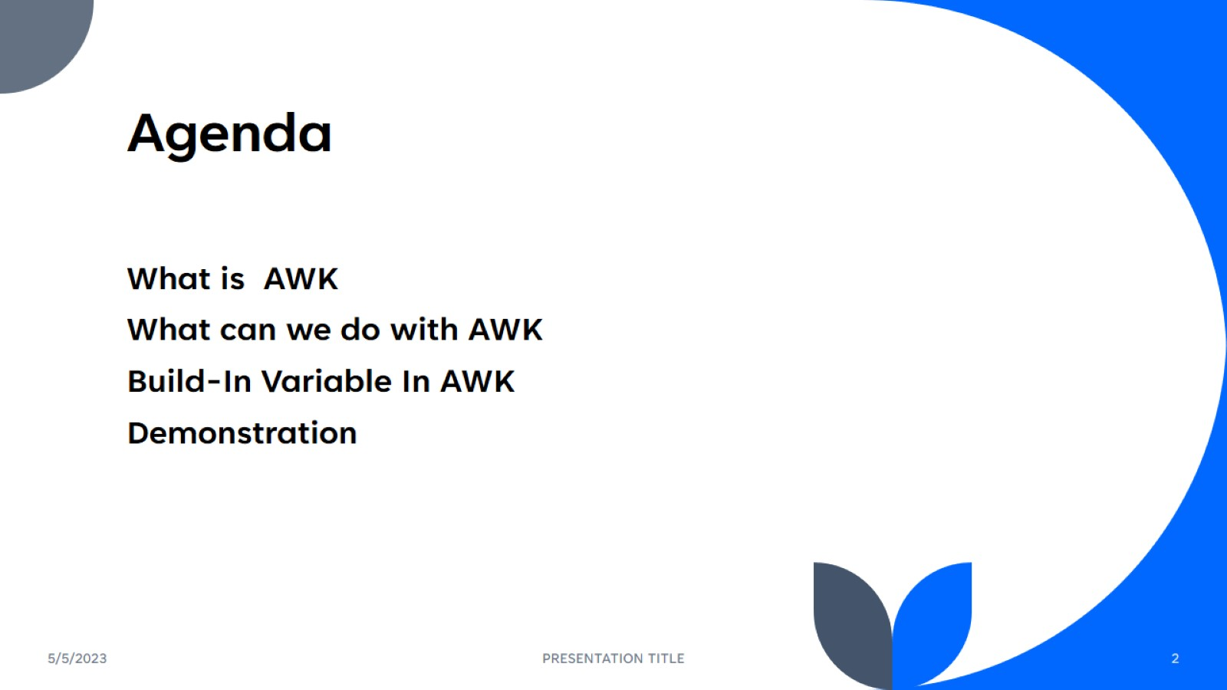
Agenda

Slide 3
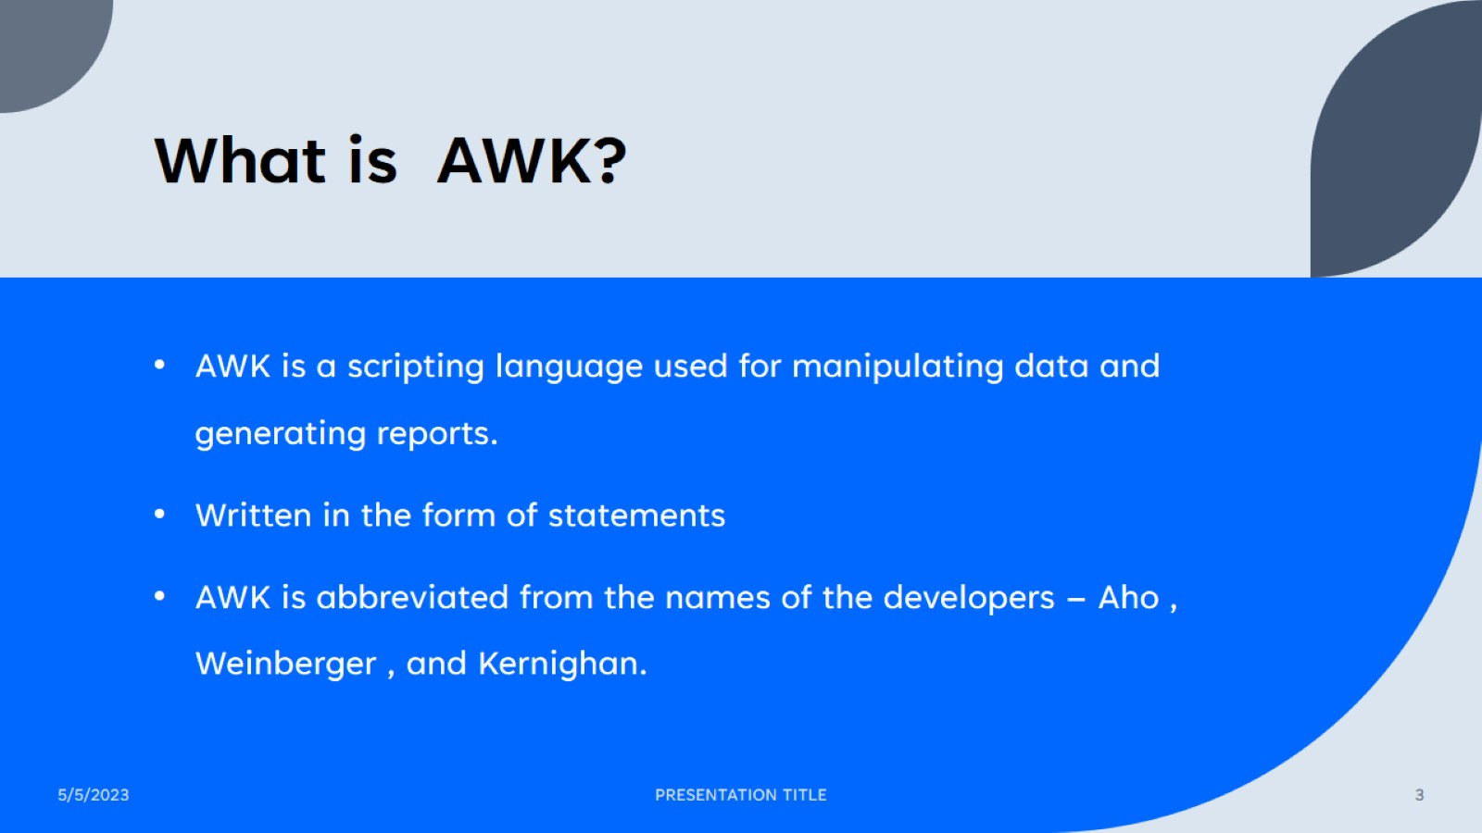
What is AWK?

Slide 4
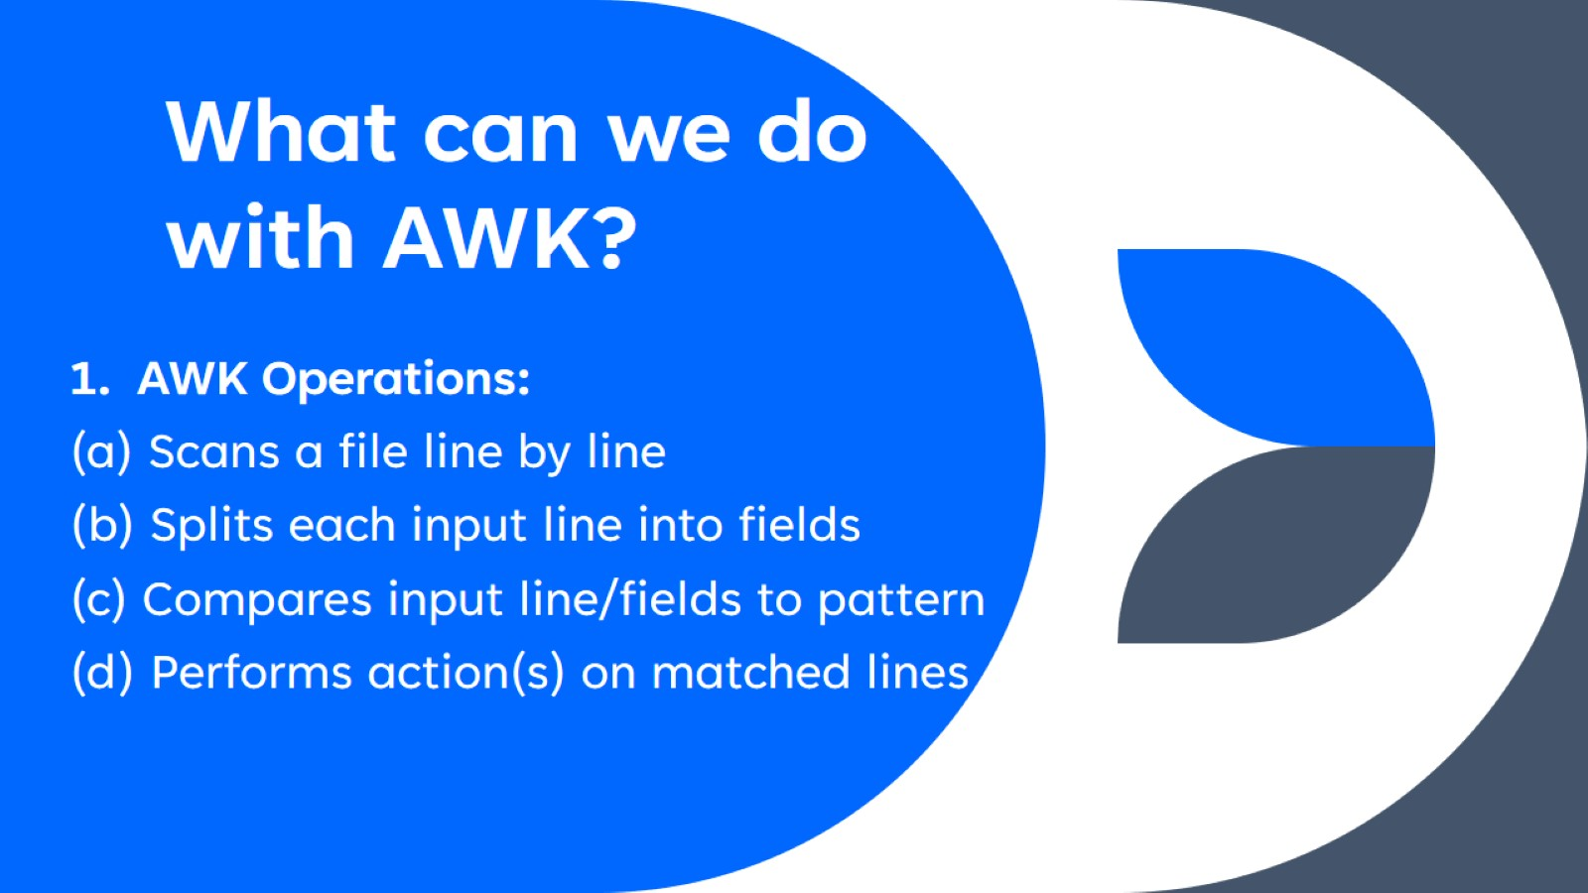
What can we do with AWK?

Slide 5
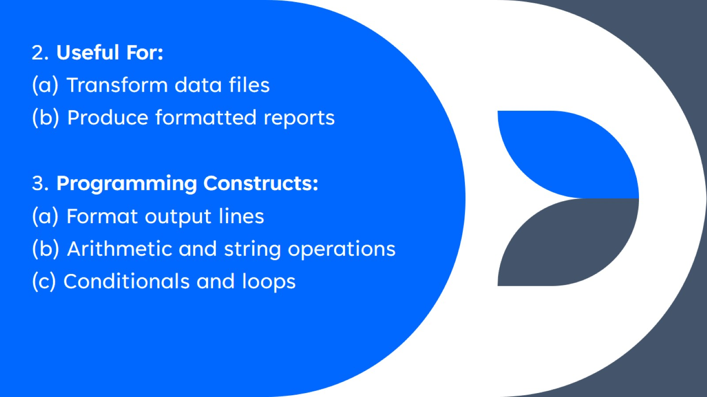

Slide 6
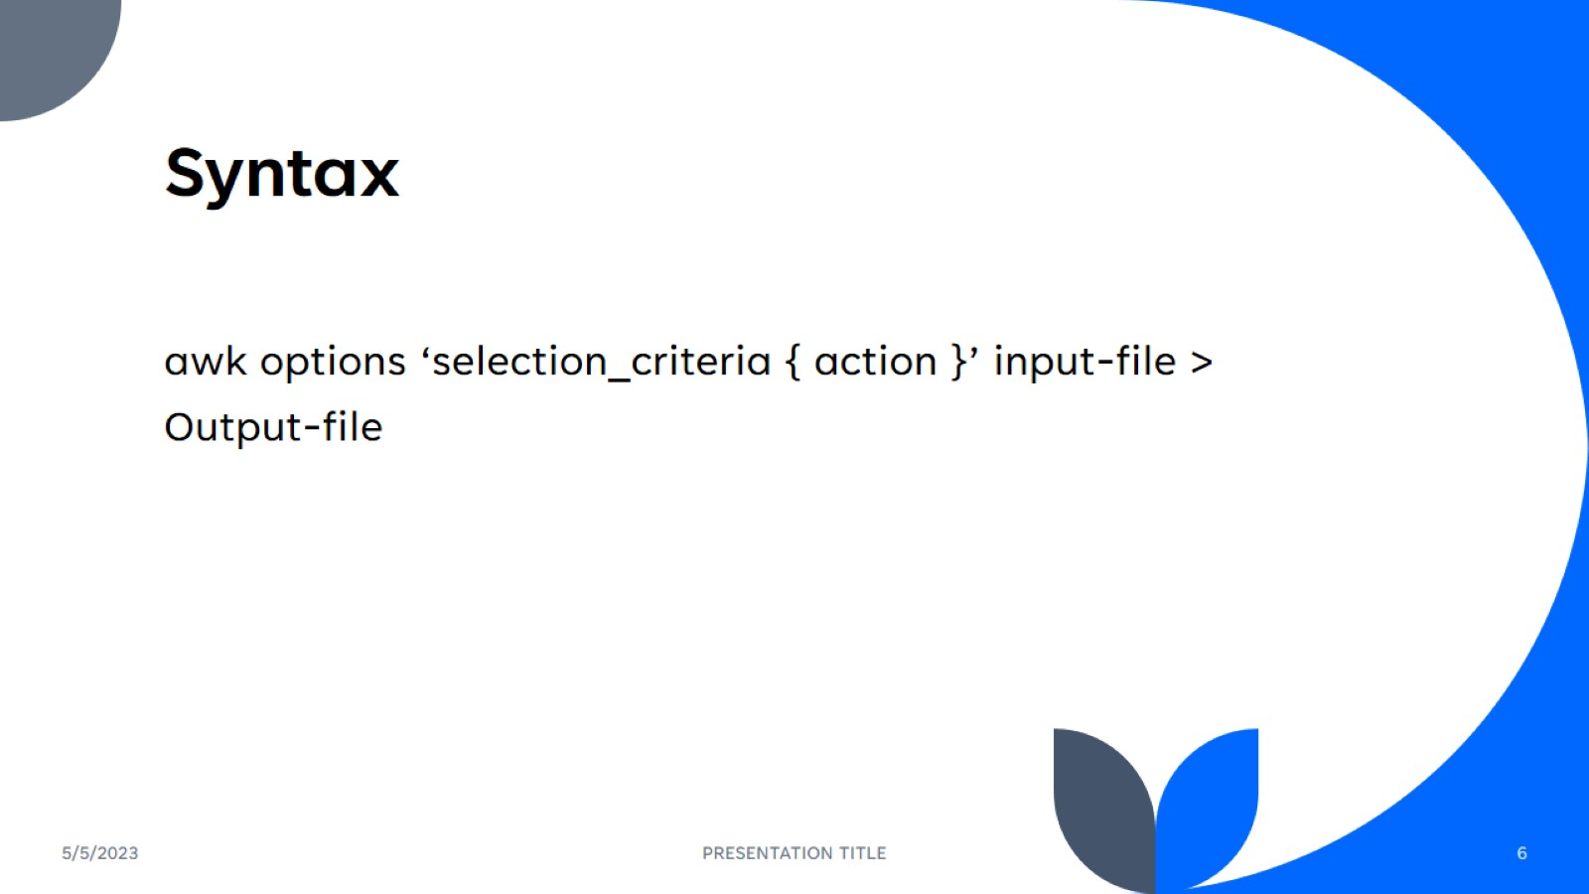
Syntax

Slide 7
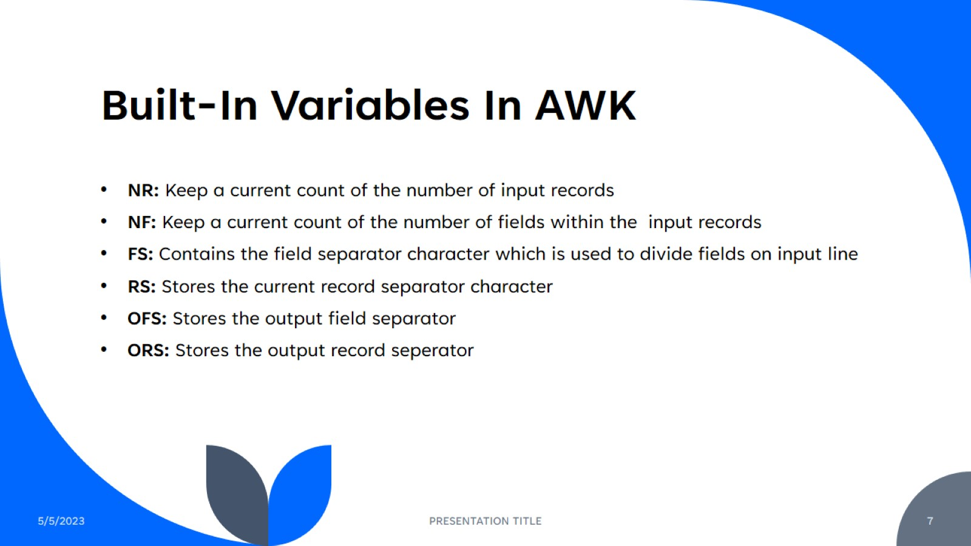
Built-In Variables In AWK

Slide 8

Q&A

